Slide 1

AI-Enhanced Blog Management System
Team members:
Raveen. P 221701046
Sharvesh. S 221701052

Slide 2
Abstract
The project proposes a platform to simplify the creation, organization, and publication of blog content. It provides users with an intuitive interface to create,read,update and delete their blogs.Our project also features user authentication, ensuring secure access and personalized dashboards. By our proposed system the main aim is to streamline content workflows, enhance user engagement, and improve productivity for individual bloggers or small teams by providing AI content enhancement features. The blogs uploaded will be stored real time in database enabling it to be visible to all users anytime.

Slide 3
Introduction
This project presents an innovative blog management system that addresses critical limitations in existing platforms by incorporating AI-powered content enhancement, visual preview capabilities, and gamification elements. The project aims to revolutionize the blogging experience by providing an intuitive platform that combines ease of use with powerful features, making content creation and management accessible to users of all skill levels.This comprehensive methodology ensures the development of a user-friendly, feature-rich blogging platform that addresses the limitations of existing systems while incorporating modern engagement features.

Slide 4
Key Objectives
1
Intuitive Interface:
Develop an intuitive, beginner-friendly user interface.
2
AI-Powered Enhancement:
Implement AI-powered content analysis and enhancement features.
3
User authentication:
Implement user authentication features which makes it secured.
4
API-testing:
Develop and verify proper execution of API operations.

Slide 5
Literature Survey: Existing System Limitations
Feather
Ghost
WordPress
In order to create content feather heavily relies on notion which is
becoming inefficient as AI is widely preffered and used.
There are no free plans available for bloggers forcing them to pay irrespective of how small or big bloggers they are.
New bloggers find it difficult to navigate and adapt to the platform’s options while creating blogs i.e it has a steep learning curve.

Slide 6



Methodology
Content Enhancement
Unit testing
Content Enhancement algorithms.
Checks whether each operation returns the correct output.
MERN Stack
Frontend: React JS for creating components of the website.
Backend:Express Js and node used to establish server to recieve requests.
Database: MongoDB to store created posts and authorized users.
Styling Frameworks: React oriented bootstrap or scss.

Slide 7
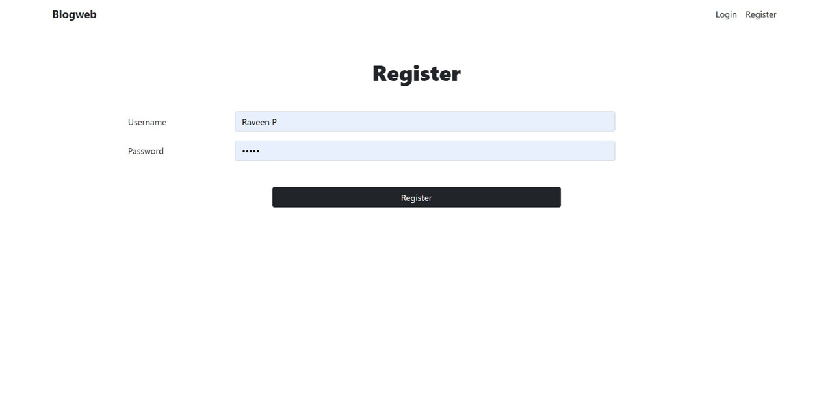
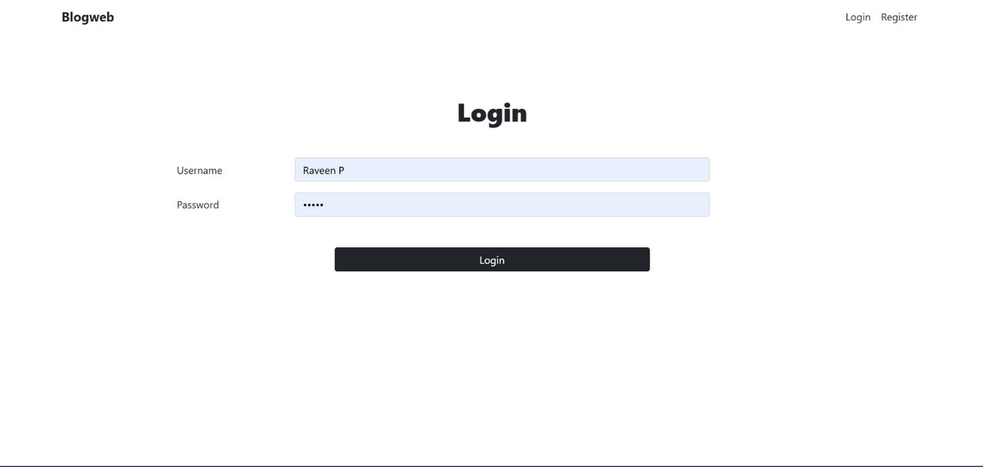
Expected Output
Github link
https://github.com/Raveen10/CD19651

Slide 8

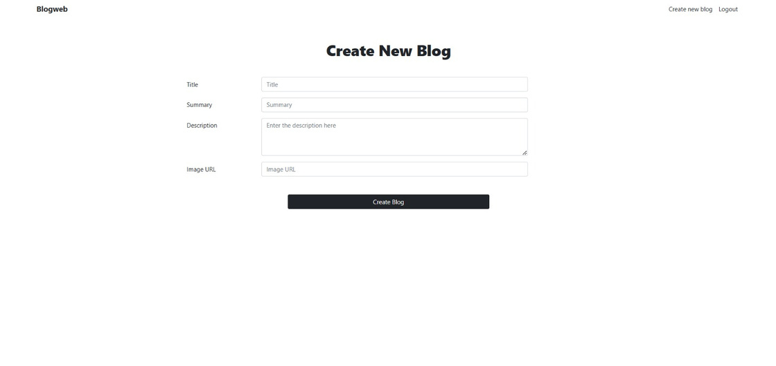
Expected Output

Slide 9
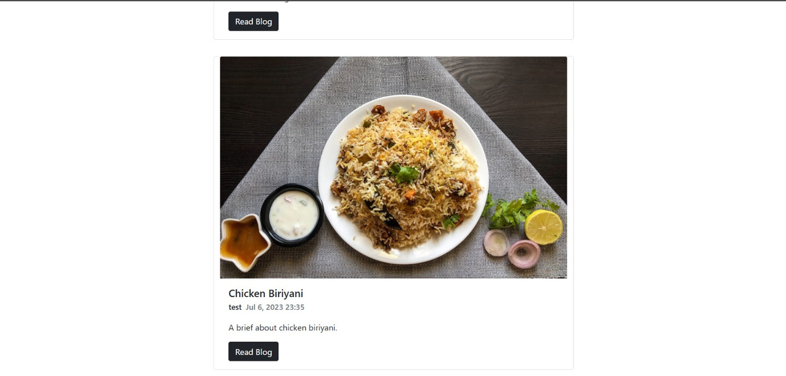
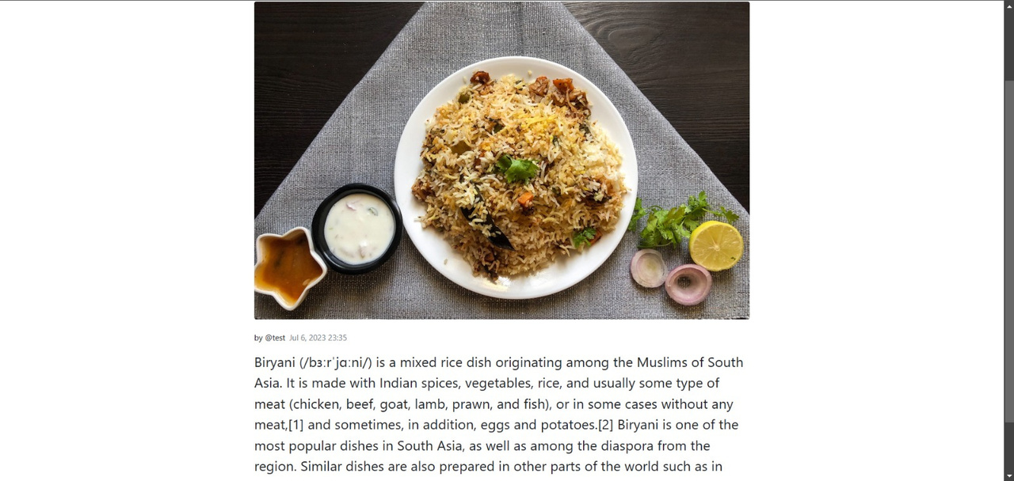
Expected Output

Slide 10
Thank You

